Slide 1
SPARSE UNMIXING AND SLIC IMPLEMENTATION

Slide 2
Linear Mixture Model
The LMM assumes that the HSI can be represented as a linear combination of several pure spectral signatures, and it has been widely used in hyperspectral unmixing. Given an HSI with n pixels, for one of the pixels, it can be written as follows:
y=Mx+n
y = [y1, y2,...,yl]T is a vector denoted as a spectral signature of a mixed pixel, and l is the number of spectral bands.
M = [m1, m2,...,mp] isanl × p spectral signature matrix containing p endmembers, and mj is the jth endmember.
x = [x1, x2,...,xp]T is a p × 1 abundance vector, and xj represents the proportion of the jth endmember in this mixed pixel.

Slide 3
Sparse Unmixing
When a standard spectral library is introduced as prior knowledge to circumvent the challenge of endmember iden tification, the traditional LMM can be extended to a sparse unmixing model.
Because the endmember information has been previously obtained in the spectral library, the goal of the sparse unmixing is to find the best combination of observed spectra from the large spectral library.
The equation is now modified to y=Ax+n
where A ∈ R (l×m) is the standard spectral library containing the m endmembers’ signatures for unmixing
Because only a few endmembers in spectral library A participate in mixed spectra y, x contains many zero values, which means that x is sparse.

Slide 4
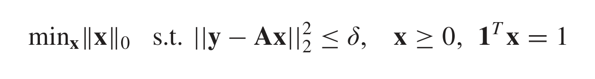
Building the objective function
The original LMM can then be redefined as an l2–l0-norm optimization problem as follows:
where δ represents the error of the reconstruction between Ax and mixed pixel y.
|| ||0 is the l0-norm, which denotes the number of nonzero components of a vector.

Slide 5
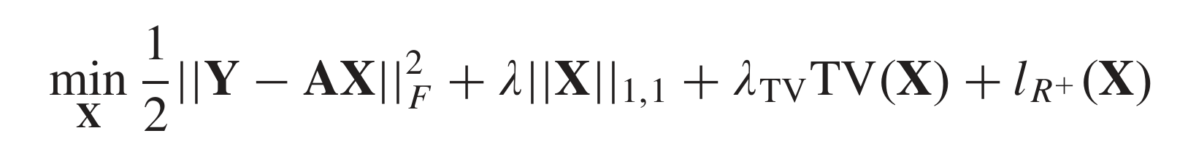
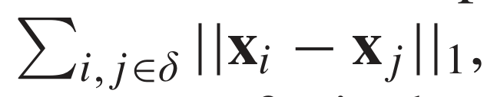
Modified objective function
Dss
TV was used as the correlation to enhance the similarity of the local pixel abundance values
By minimizing the gradient sum of the horizontal and vertical directions of the abundance matrix, this method can not only consider the similarity of the abundance map but also achieve denoising for the randomly distributed noise

Slide 6
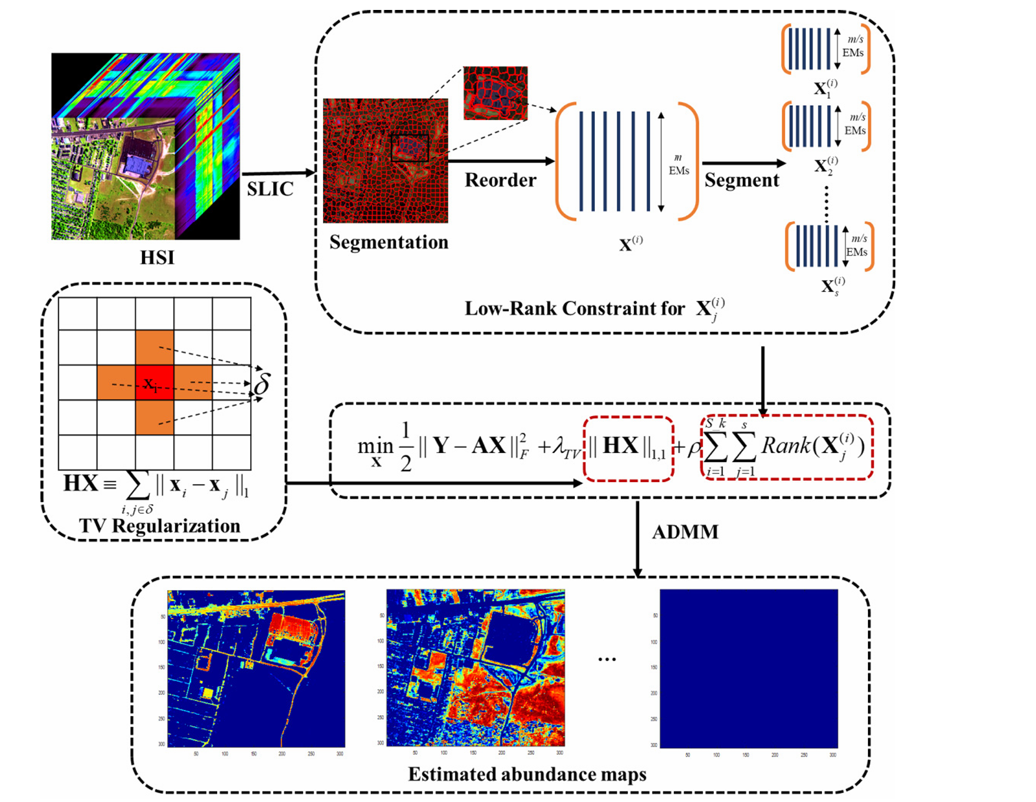
Flowchart

Slide 7
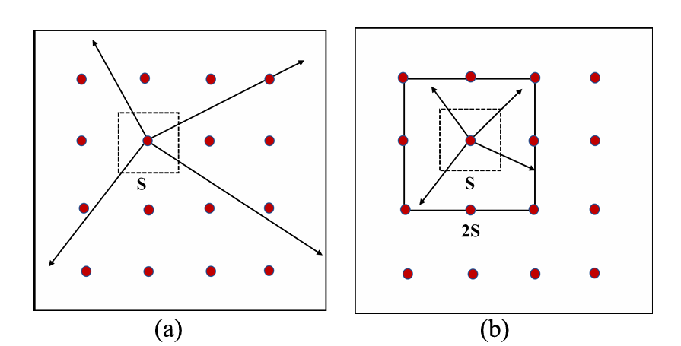
Slic and Superpixel segmentation
Pixels within a homogeneous region are spatially compact and tend to exhibit similar reflection spectra, indicating that these pixels may share the same endmembers and similar abundance values.
To obtain the homogeneous regions, superpixel segmentation can be introduced to form a series of regions containing unique semantic information (spatial information and spectral information)
Based on the SLIC method, the location information and color (or spectral) information can be better considered.
The SLIC algorithm can be seen as a localized version of the k-means clustering method.

Slide 8
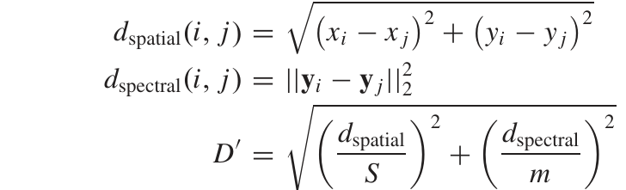
By considering both the spectral distance and the spatial distance, the current pixel is clustered to the nearest seed point. These distance metrics are defined as follows:
where (xi, yi), (xj, yj) represent the position,
yi, yj are the spectra of pixels i and j, respectively, and m is a balancing weight

Slide 9
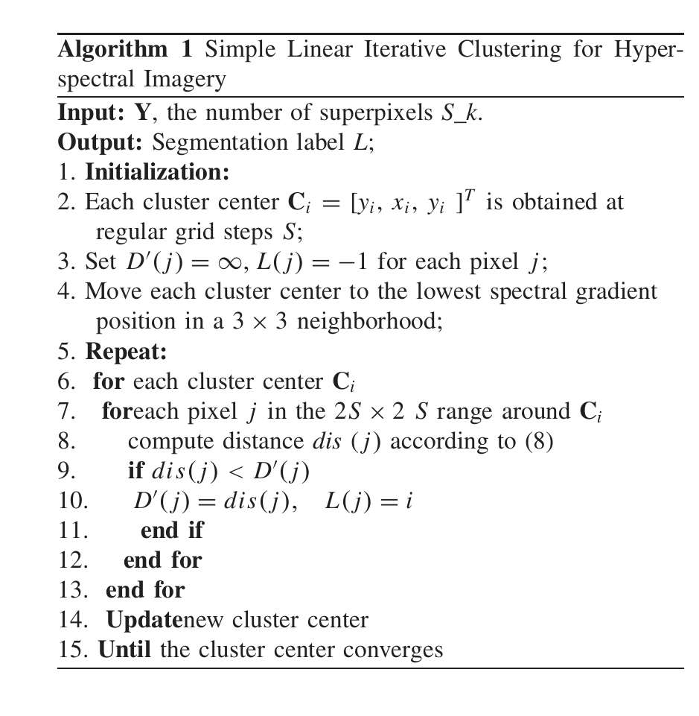
Slic Pseudocode

Slide 10

Why Use 3D?
2D Slides
3D Models
Slides are a static portrait.
3D helps foster conceptual understanding and visual and spatial thinking.
Audience is passive and cannot interact.
Animated 3D models display objects within space in ways text and images cannot.

